Slide 1
Defcon 2019 DFIR CTF
Memory Forensics

Slide 2
Memory dump
Belkasoft Ram Capturer,
FTK imager
Computer Aided INvestigative Environment (CAINE)
Helix
LiME (Linux Memory Extractor)
https://opensource.com/article/21/4/linux-memory-forensics
DD
DC3DD
can be used to acquire the memory image, or memory dump, and then be investigated and analyzed by the tools within the Volatility Framework

Slide 3
Volatility supports several memory dump formats (both 32- and 64-bit)
Windows crash and hibernation dumps (Windows 7 and earlier)
VirtualBox
VMWare .vmem dump
VMware saved state and suspended dumps—.vmss/.vmsn
Raw physical memory—.dd
Direct physical memory dump over IEEE 1394 FireWire
Expert Witness Format (EWF)—.E01
QEMU (Quick Emulator)

Slide 4
Memory Analysis

Slide 5
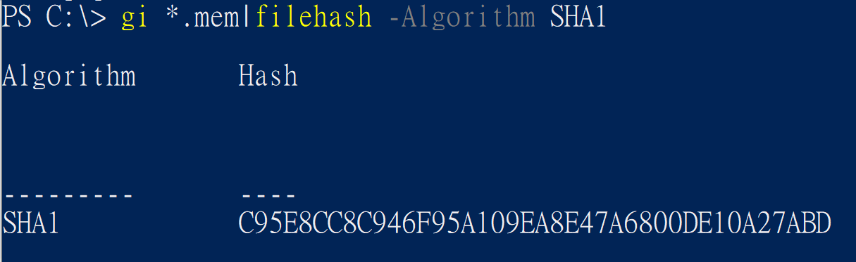
gi *.mem|filehash -Algorithm SHA1
flag<C95E8CC8C946F95A109EA8E47A6800DE10A27ABD>

Slide 6
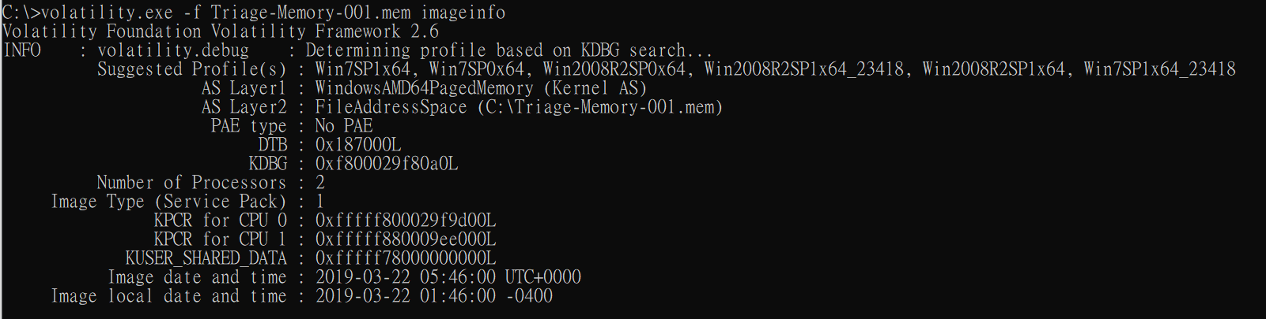
volatility.exe -f Triage-Memory-001.mem imageinfo
flag<Win7SP1x64>

Slide 7
volatility.exe -f Triage-Memory-001.mem kdbgscan

Slide 8
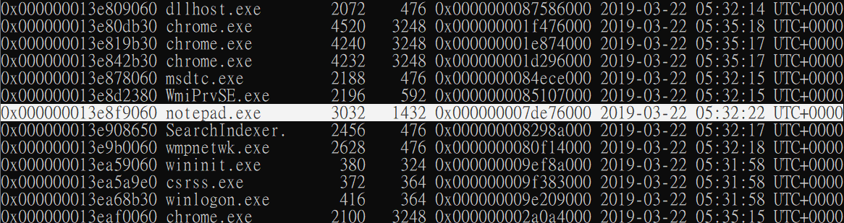
volatility.exe -f Triage-Memory-001.mem --profile=Win7SP1x64 psscan
flag<3032>

Slide 9
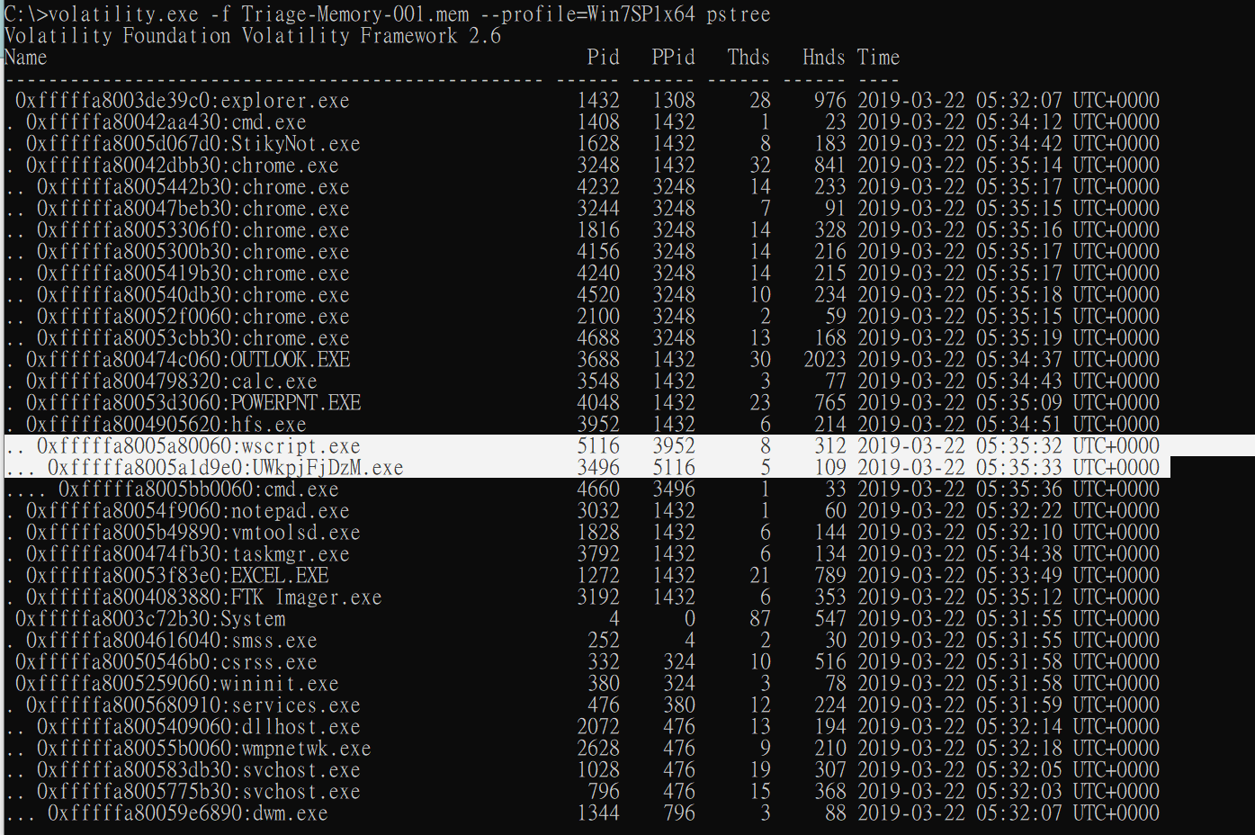

Slide 11
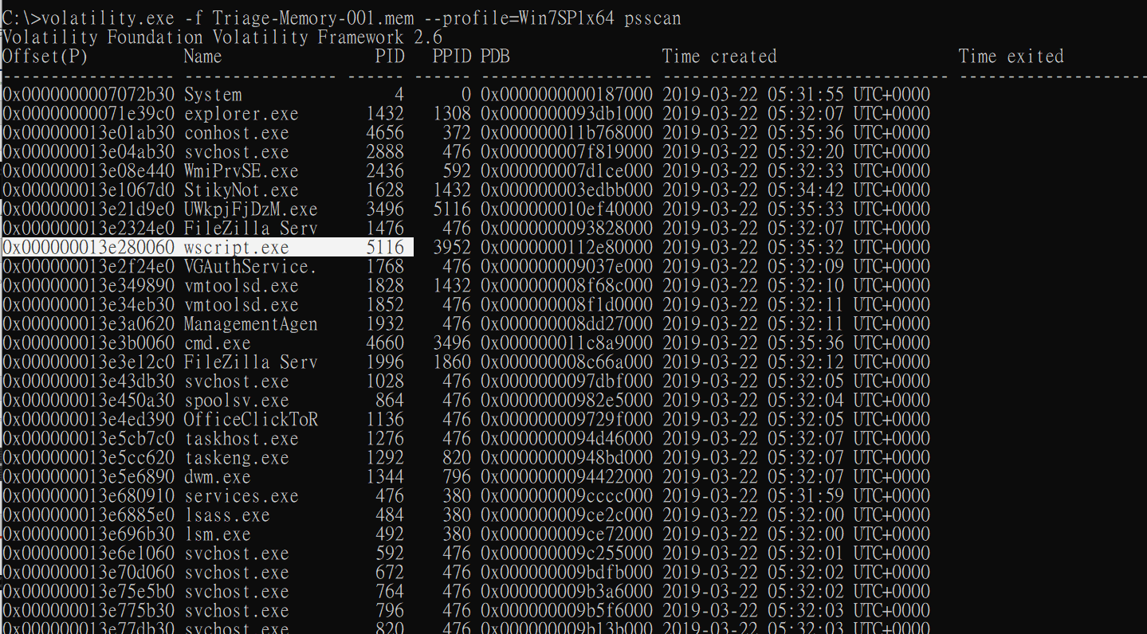
flag<UWkpjFjDzM.exe>

Slide 12
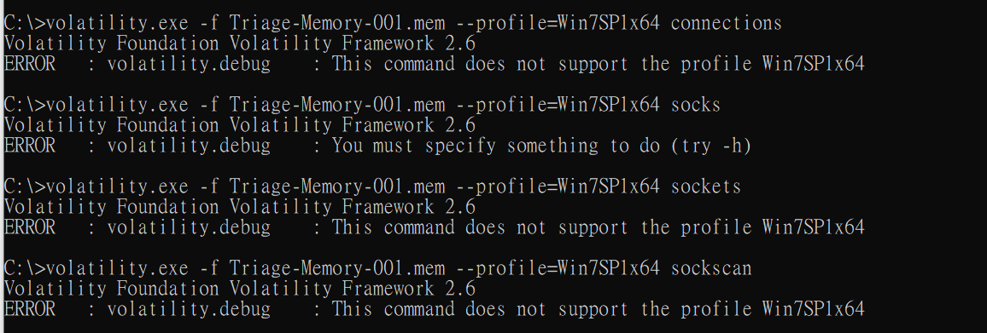

Slide 13
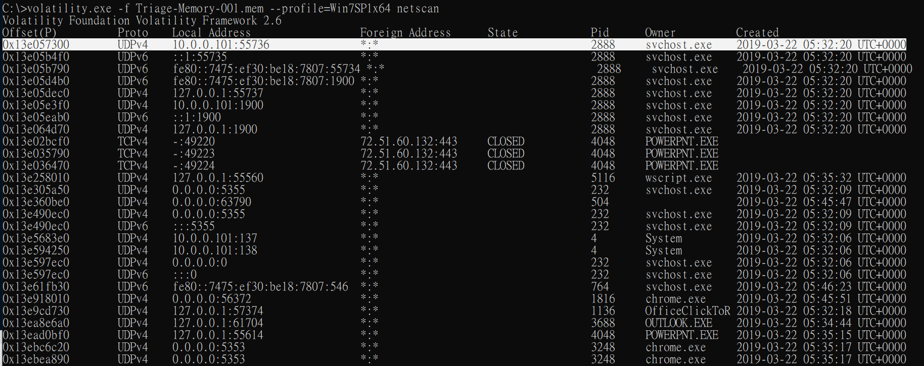
volatility.exe -f Triage-Memory-001.mem --profile=Win7SP1x64 netscan

Slide 14
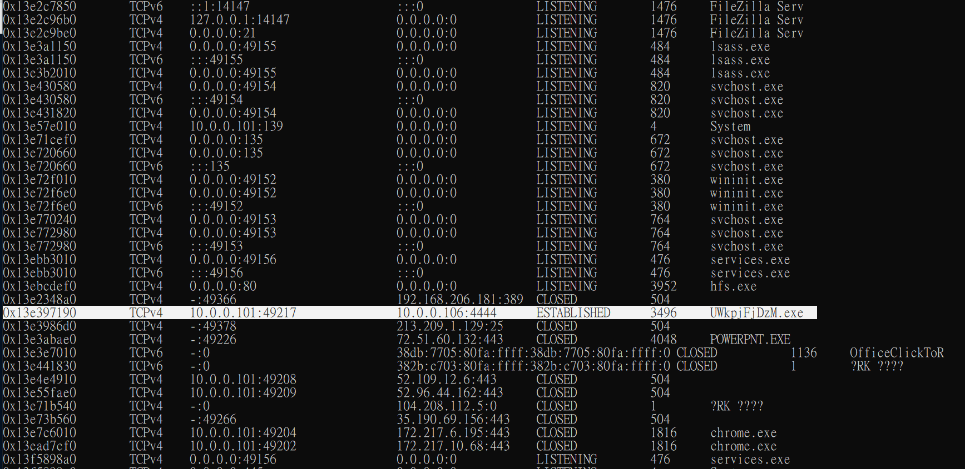
flag<10.0.0.106>

Slide 15
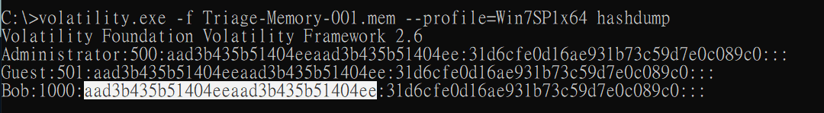

Slide 16
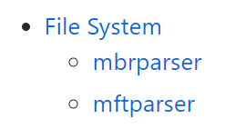

Slide 17
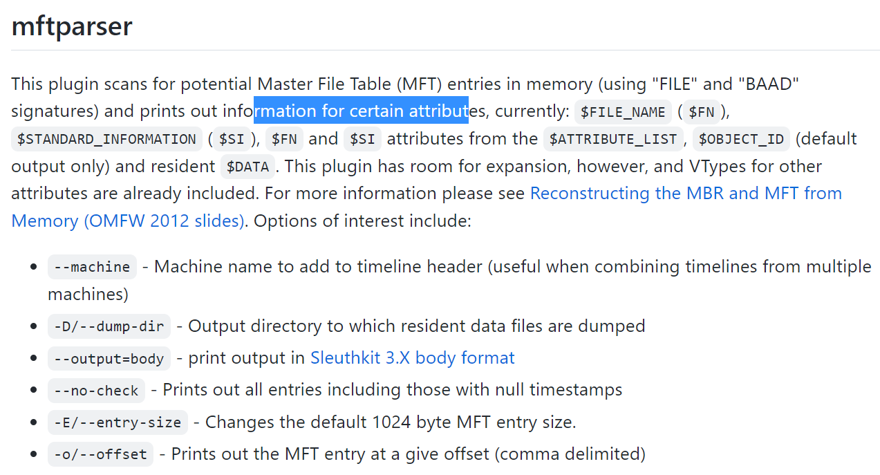
https://github.com/volatilityfoundation/volatility/wiki/Command-Reference#mbrparser

Slide 18
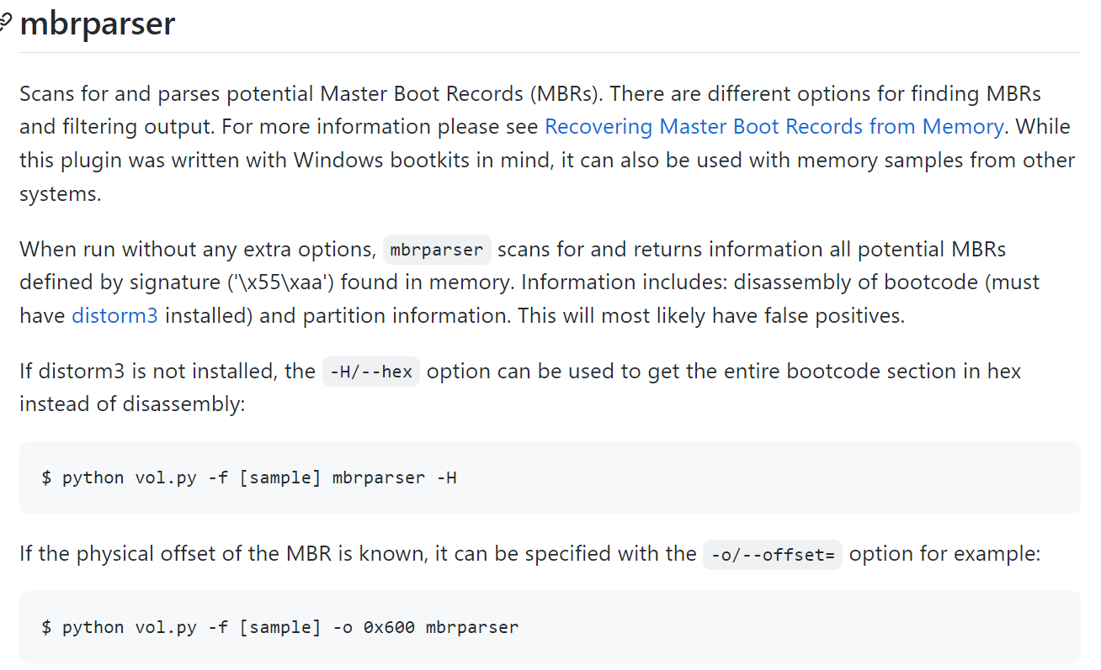
https://github.com/volatilityfoundation/volatility/wiki/Command-Reference#mbrparser

Slide 19
